Slide 1
Automatic Root Cause Analysis via Large Language Models for Cloud Incidents
EuroSys
刘军辉
2026/2/1

Slide 2

Background and Motivation
Cloud Incident Background
Cloud computing is critical infrastructure for modern services
Reliability, availability, and security are increasingly important
Cloud systems are complex and incident-prone
1
Why RCA is Hard
Information Spectrum
Manual analysis of logs, metrics, traces, tickets
Labor-intensive and error-prone
Heavy reliance on human expertise
Too little information → insufficient for diagnosis
Too much information → information overload
Relevant signals buried in noisy, inconsistent data
2
3

Slide 3
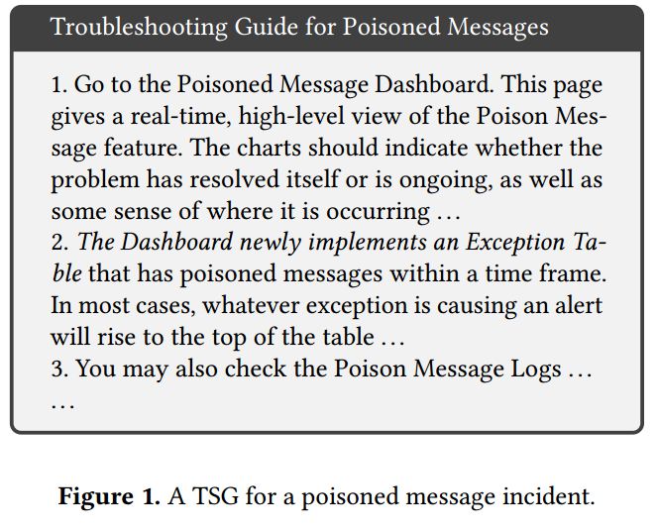
Traditional Approaches to Cloud Incident RCA
troubleshooting guides (TSG)
Manual Data Integration
Outdated Information
Insufficient Details & Coverage
Manual data collection from multiple sources. Time-consuming and error-prone. High cognitive load on OCEs. Causes stress and burnout. Even with TSG recommendation systems.
Static documents. Hard to keep up with system evolution. New features and root causes not covered. May lead to outdated or suboptimal actions. “Exception Table not immediately added to TSG”.
High-level instructions only. Lack of concrete and actionable guidance. Confusing for less experienced OCEs. Missing common checks .

Slide 4
LLMs for RCA
Process high-volume textual data
Identify relevant information
Generate concise and insightful summaries
Reduce manual effort for OCEs
Adapt to evolving incident types
LLMs’ Strengths
Lack of domain-specific knowledge
Limited understanding of cloud incident context
Inaccurate root cause prediction
Weak explanations without guidance
Limitations of Direct LLM Usage
but
Miss rich diagnostic signals
High cost of fine-tuning
Require large labeled datasets
Hard to continuously update
Prone to hallucination over time
finetuning has several limitations
Use only incident title & summary
finetune a LLMs with domain-specific datasets
root causes

Slide 5
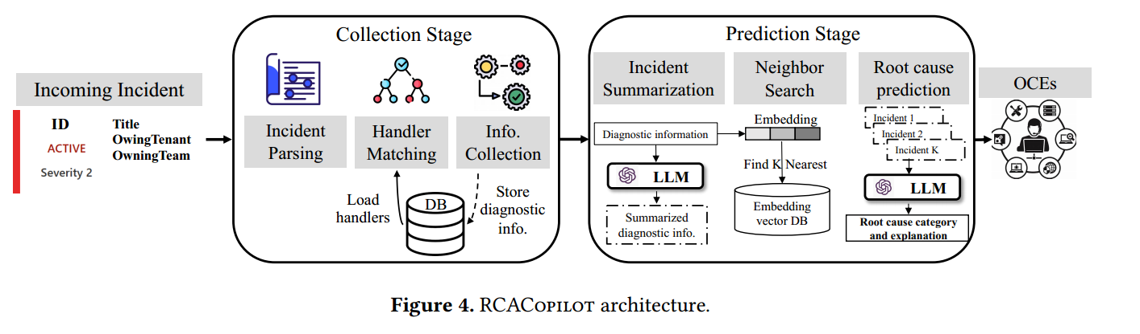
RCACopilot

Slide 6

Insights from Incidents
a comprehensive study of the one-year incidents from an email service from Microsoft
Dataset & Method：
One-year incident data from a Microsoft email service
Incidents reviewed and categorized by experienced OCEs
Qualitative analysis based on real production cases
Incident characteristics & impact ：
Root cause types and sources
Response effectiveness
Recurrence of similar incidents

Slide 7
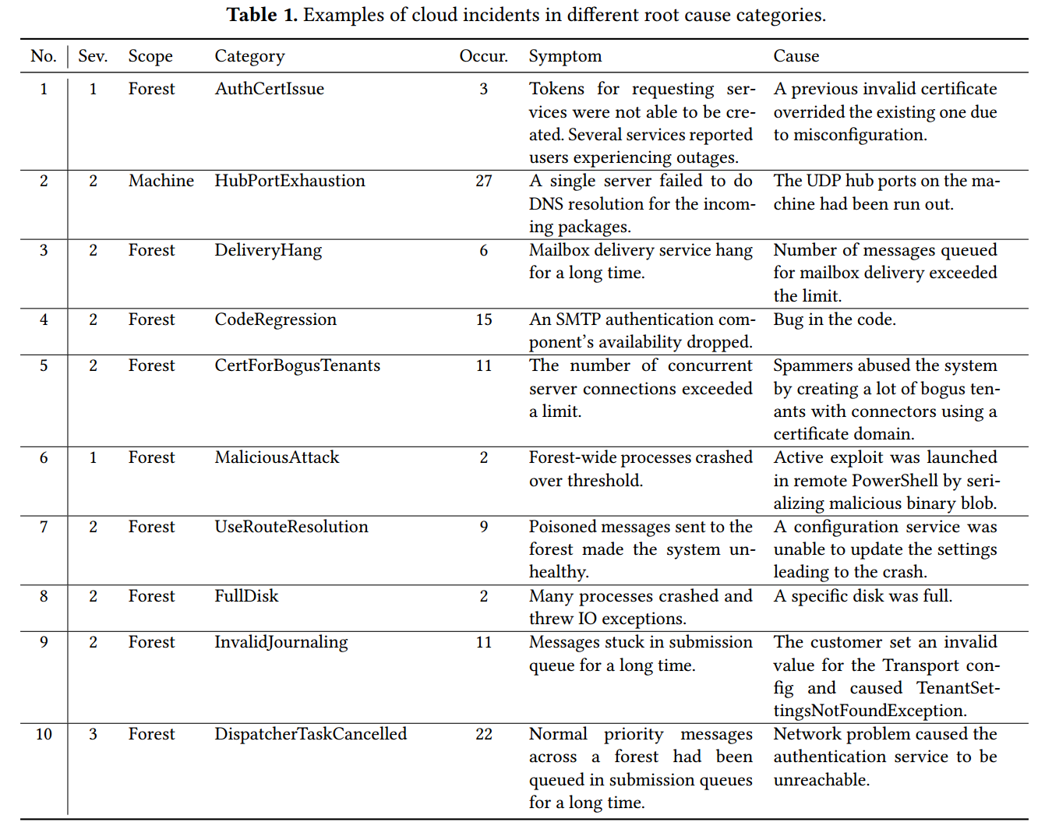
Insights from Incidents

Slide 8
Insight 1: determining the root cause based on a single
data source can be challenging
[UDP Hub Ports Exhausted] ↓ [DNS Resolution Failure]
==========================
[Mailbox Server cannot resolve Front-door address] ↓ [SMTP Proxy Connection Request Fails] ↓ ----------------------------------------------- | [Monitor Alert: Connection failure] | | (Observable symptom only) | -----------------------------------------------

Slide 9
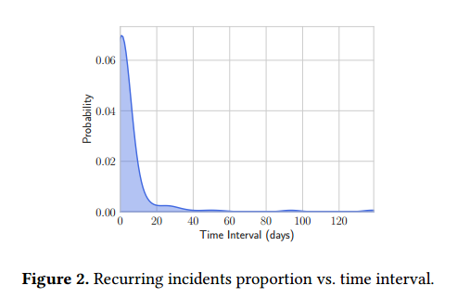
Insight 2: incidents stemming from similar or identical root causes often recur within a short period.

Slide 10
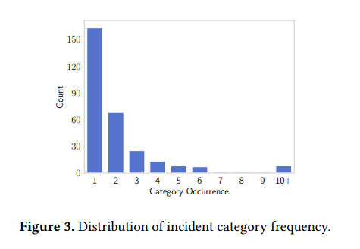
Insight 3: incidents with new root causes occur frequently and pose a greater challenge to analyze

Slide 11
RCACopilot

Slide 12
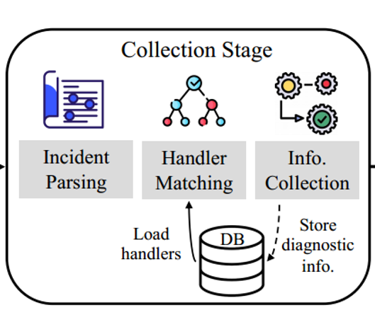
Diagnostic Information Collection Stage
Insight-1 ：determining the root cause based on a single data source can be challenging → Incident Handler
┌────────────┐ ┌────────────┐ │ Alert Type │───>──┐ │ Multiple Data Sources │ └────────────┘ └────────────┘ ↑ Symptoms / Issues
Alert Type │ ┌───────┐ │ │ Action A Action B │ │ Action C Action D │ Mitigation
| three distinct actions:| | ------------------- | | **Scope Switching** | | **Query** | | **Mitigation** |
Handler v1 ──> Handler v2 ──> Handler v3 ↑ ↑ New Metric New Root Cause
Human Expertise (OCEs) ───> Reusable Actions
System Automation

Slide 13
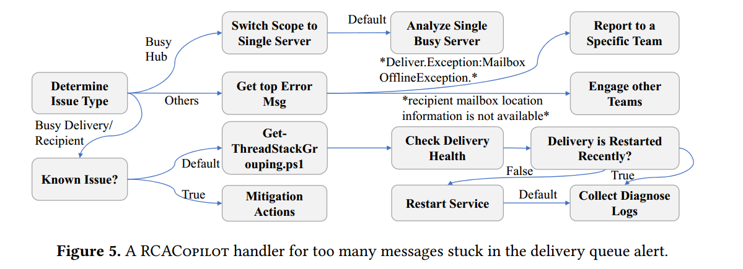
Handler action——Scope switching action

Slide 14
Handler action——Query action

Slide 15
Handler action——Mitigation action

Slide 16
Root cause prediction stage:
Chain-of-Thoughts (CoT) prompting is a gradient-free technique that elicits LLMs to generate intermediate reasoning steps that
lead to the final answer. In few-shots CoT prompting, a few manual demonstrations that are composed of a question and a reasoning
chain that leads to an answer for each of them

Slide 17
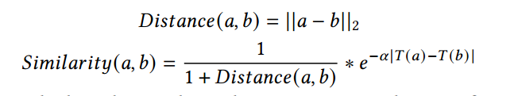
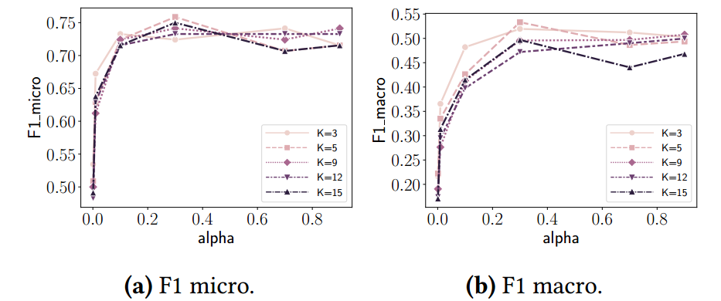
Embedding model And Nearest neighbor search.
FastText
which is efficient, insensitive to text input length, and generates dense matrices, making it easy to calculate the Euclidean distance between similar vectors.

Slide 18
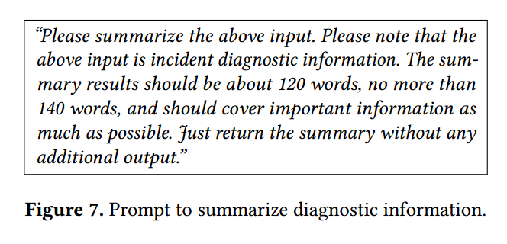
Diagnostic information summary
- RCACopilot typically collects > 2000 tokens of diagnostic information - Low log readability - Direct processing by LLM will: • Be difficult to understand • Introduce noise
- Utilize LLM's automatic summarization capabilities - Compress raw diagnostic information to 120-140 words - Remove irrelevant information to improve readability - Use the summary text as input for subsequent CoT prompting

Slide 19
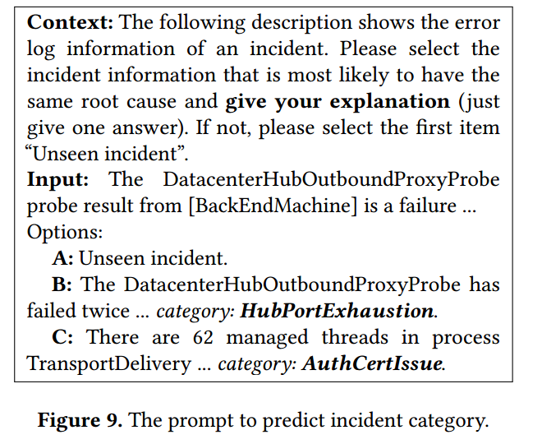
Prediction prompt construction
The final prompt is designed to perform three key steps: · Provide the LLM with several summaries of similar historical incidents, along with their known root cause labels
· Present the summary of the current incident to be diagnosed · Explicitly instruct the LLM to: Select the historical incident that is most likely to share the same root cause, and Explain the reasoning behind its decision (“give your explanation”)

Slide 20
Evaluation-Target System and Dataset
System & Dataset - Evaluated on Microsoft Global Email Service (Transport) - 653 real-world incidents collected over one year Ground Truth - Root cause categories manually labeled - Annotated by experienced On-Call Engineers (OCEs) Data Split - Training set: 75% - Testing set: 25% LLMs Used - GPT-3.5-turbo - GPT-4 (8K tokens) Default Model - GPT-4, selected for its best overall performance

Slide 21
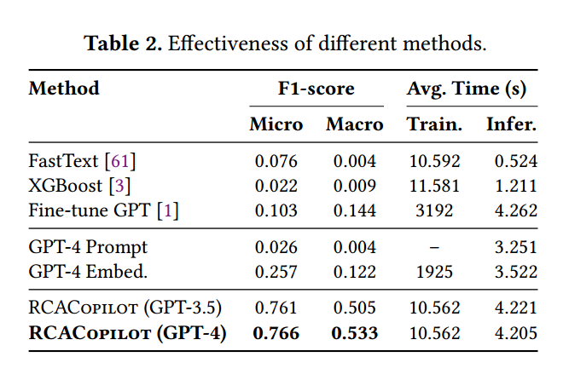
Evaluation-Compared Approaches

Slide 22
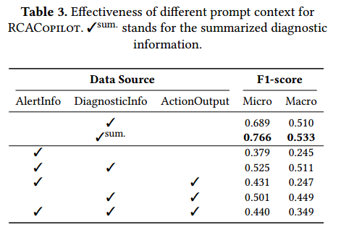
Evaluation-ablation study

Slide 23
Evaluation
(1) How effective and efficient is RCACopilot as an on-call system when predicting root cause categories and assisting OCEs?
RCACopilot achieves 0.766 and 0.533 for Micro-F1 and Macro-F1 separately when predicting the root cause category of cloud incidents, outperforming all our baselines with a low running overhead (4.205 seconds).
RCACopilot is also able to generate new root cause category labels for unseen incidents with explanations.
(2) How do different components of RCACopilot facilitate its diagnosis and prediction?
RCACopilot has proven that the diagnostic information collection component, GPT summarization, and chain-of-thoughts
prompting all contribute to RCACopilot’s prediction effectiveness.
(3) Is RCACopilot suitable for deployment in real production services, and are RCACopilot’s results trustworthy?
RCACopilot’s diagnostic information collection module has been deployed across 30 teams within Microsoft for over four years.
To evaluate the trustworthiness of RCACopilot, each experiment was conducted over three rounds, and RCACopilot can consistently achieve a high Micro-F1 score of over 0.70 and a Macro-F1 score exceeding 0.50.

Slide 24
Thank You
刘军辉
2026/2/1

